Slide 1
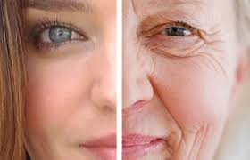
Rizici prijevremene menopauze
Prof.dr.sc. Marina Šprem Goldštajn

Slide 2
Ukupno 4267558 Ž 2 208 857 M 2 058 701 do 40-te 981 174 Podaci Državnog zavoda za statistiku RH, 2014.
Učestalost prijevremene menopauze
1-4% žena do 40.te godine života
5% rana menopauza ( 40-45.godina)
0.1% < 30 godina
1/1000 žena do 30.te godine
1/250 do 35.te godine
1/100 do 40.godine CRO – 9811 žena

Slide 3
Prijevremena menopauza
Spontana
Inducirana
Amenoreja
Hipoestrogenizam
Porast gonadotropina
Klimakterične smetnje
Neplodnost
idiopatski
kirurški
Terminologija
Hipergonadotropni
hipogonadizam
POF
POI
PM
Ovarijska disgeneza
genetski
kemoterapija
enzimski
defekti
zračenje
autoimuni
pušenje
infekcije
Metaboličke bolesti

Slide 4
Genetski
Enzimski
defekti
X- kromosomski poremećaji
Monosomija X, Turnerov sindrom
X izokromosomi
Genetski poremećaj kratkog i dugog kraka X kromosoma
Mikrodelecije
POI u 46,XX
Gonadal na disgeneza
Cerebelarna ataksija
Gonadalna disgeneza i multiple malformacije
Mutacije enzima važnih za reprodukciju
Galactose 1-phosphate uridylyltransferase deficiency (galactosemia)
Carbohydrate-deficient glycoprotein deficiency
17 α-hydroxylase/17,20 desmolase deficiency
Mutacija aromataze
Mutacije hormonskih receptora/aktivnosti
Mutacije FSH/LH receptora

Slide 5
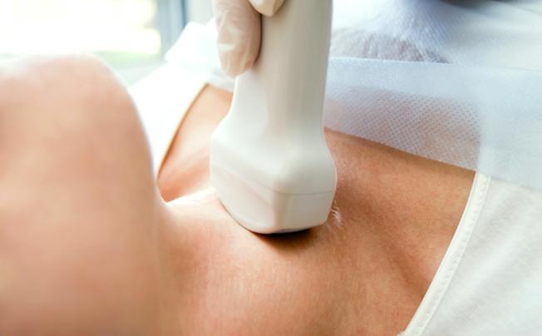
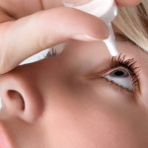
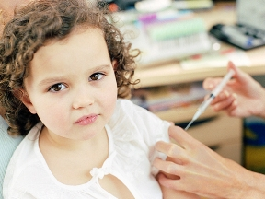
Autoimuni
Metaboličke bolesti
Infekcije
Mumps
Tuberkuloza
HIV infekcija ili antivirusno liječenje
Autoimune poliendokrinopatije
Hipotireoza Adrenalna insuficijencija Hipoparatireoidizam Dijabetes mellitus tip 1
Sindrom suhog oka
Miastenija gravis
Reumatoidni artritis
SLE
Kongenitalna aplazija timusa
Stres

Slide 6
Inducirana prijevremena menopauza
Inducirana prijevremena menopauza
Kirurgija
Kemoterapija
Zračenje
Histerektomija
Neplodnost ?
Agonisti GnRh
Profilaktička
ooforektomija
Prijevremena smrt
Kardiovaskularne bolesti
Osteoporoza
Psihijatrijski problemi
Seksualna disfunkcija
Rizik- dobrobit
U onih koje nemaju povišen genetski rizik , nesigurno i kontroverzno !!
300 000 žena u SAD – prevencija CA ovarii
300 00 zbog dobroćudne etiologije

Slide 7
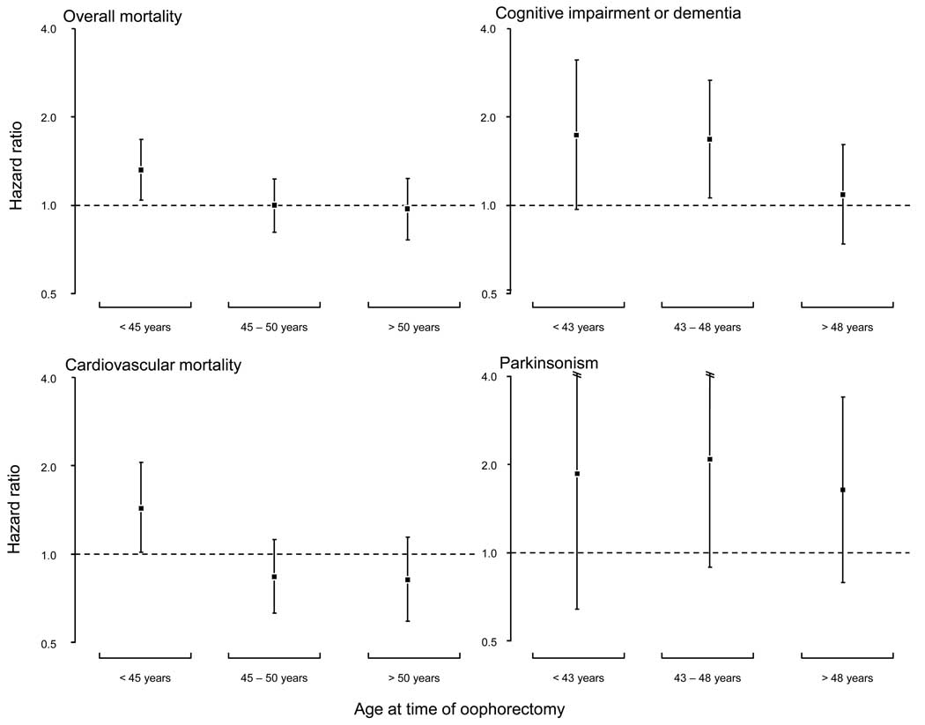
Dob nastupa menopauze
- biološki marker zdravlja i starenja
The Mayo Clinic Cohort Study of Oophorectomy and Aging /4,780 women
The Mayo Clinic Cohort Study of Oophorectomy and Aging /4,780 women
The Danish Nurse Cohort Study/ 20 000 women
Nurses’ Health Study/ 30 000 women
The Mayo Clinic Cohort Study of Oophorectomy and Aging /4,780 women
The effects of bilateral oophorectomy increased with younger age at the time of oophorectomy for several outcomes investigated by the Mayo Clinic Cohort Study of Oophorectomy and Aging .Risk was expressed using hazard ratios and 95% confidence ...
Shuster LT. Maturitas,2010.

Slide 8
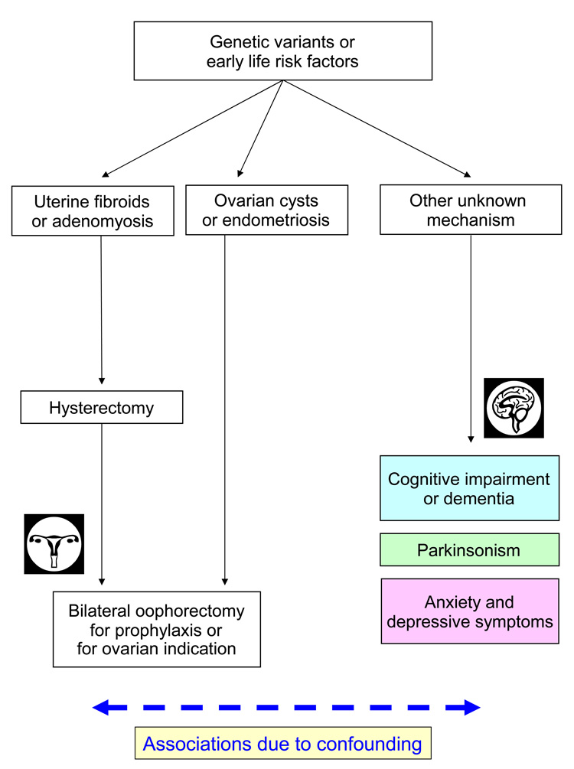
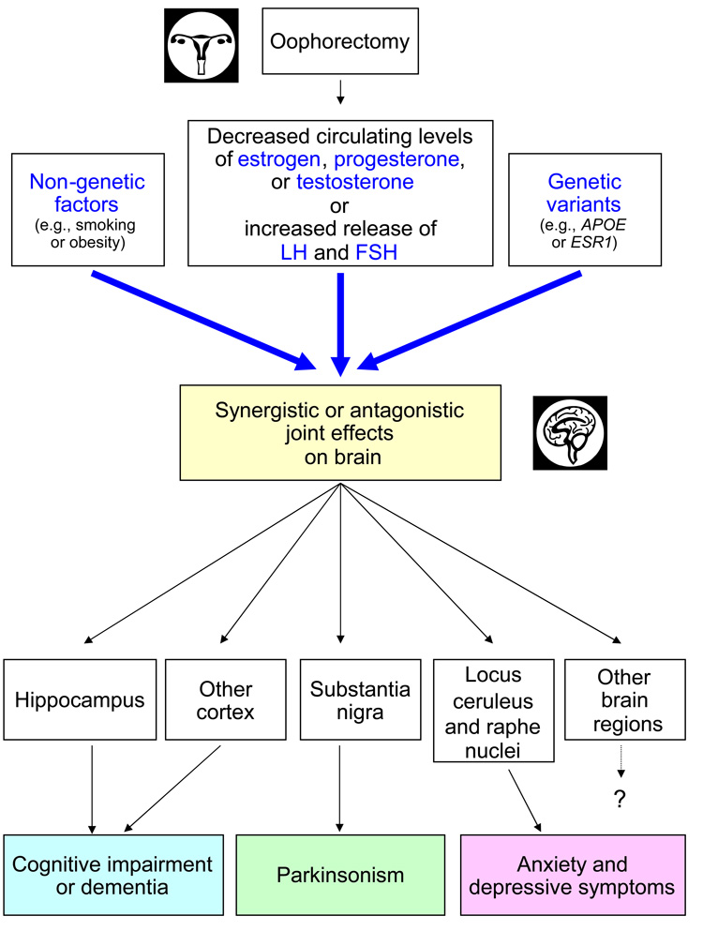
Dugoročni učinci bilateralne ooforektomije na “brain aging”
Womens Health (Lond Engl). Jan 2009; 5(1): 39–48.
Long-term effects of bilateral oophorectomy on brain aging: Unanswered questions from the Mayo Clinic Cohort Study of Oophorectomy and Aging W A Rocca,† L T Shuster, B R Grossardt, D M Maraganore, B S Gostout, Y E Geda, and L J Melton, III
Notes:
Facts (associations)
Bilateral oophorectomy performed before the onset of menopause is associated with an increased risk of cognitive impairment or dementia. The association is stronger with younger age at oophorectomy, is independent of the indication for oophorectomy, and may be offset by estrogen treatment.
Bilateral oophorectomy performed before the onset of menopause is associated with an increased risk of parkinsonism and Parkinson’s disease. The association is stronger with younger age at oophorectomy and is independent of the indication for oophorectomy, but is not offset by estrogen treatment.
Bilateral oophorectomy performed before the onset of menopause is associated with an increased risk of long-term depressive and anxiety symptoms. The association is stronger with younger age at oophorectomy and is independent of the indication for oophorectomy, but is not offset by estrogen treatment.
Possible causal mechanisms
The associations may be due to a chain of causality prompted by reduced levels of circulating estrogen.
The associations may be due to a chain of causality prompted by reduced levels of circulating progesterone or testosterone.
The associations may be due to a chain of causality prompted by an increased release of gonadotropins by the pituitary gland.
The associations may involve the synergistic or antagonistic interaction of bilateral oophorectomy with genetic variants (e.g., APOE or ESR1 genes). The interactions may be complex and may also involve other non-genetic factors.

Slide 9
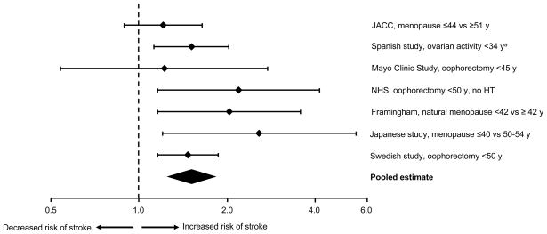
Povezanost PM i CVI /sažetak opservacijskih studija
Summary of observational studies on the association of premature or early menopause with risk of stroke. The relative risks estimated by OR or HR and 95% confidence interval were plotted using a logarithmic scale. ªA length of 34 years of ovarian activity corresponds to the occurrence of estrogen deficiency at approximately age 46 years, assuming a median age at menarche of 12 years. HT = hormone therapy; JACC = Japan Collaborative Cohort Study; NHS = Nurses’ Health Study.

Slide 10
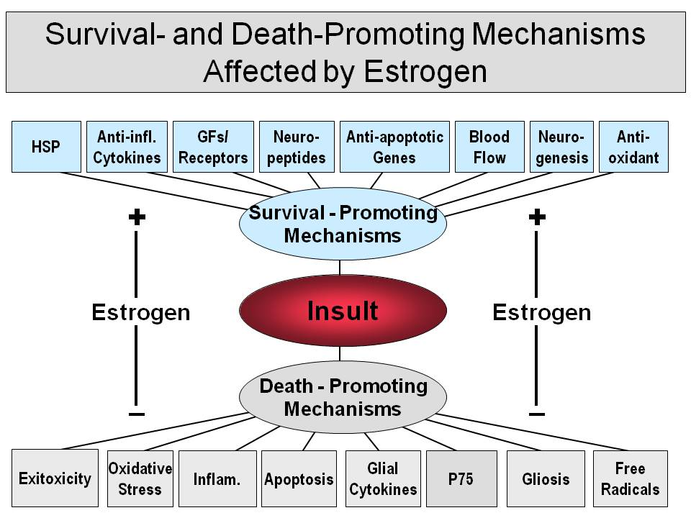

Slide 11
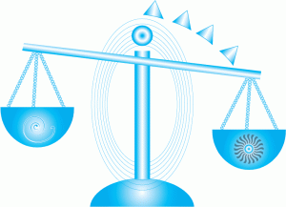
Profilaktička ooforektomija DA ili NE
Povećani rizik
Ukupni mortalitet
Kardiovaskularne bolesti
Moždani udar
Rak pluća
Kongitivne smetnje
Parkinsonova bolest
Osteoporoza i frakture
Psihijatrijski poremećaji
Seksualna disfunkcija
Informirani pristanak
Rizik/dobrobit
Komplikacije
Dugoročne posljedice kirurgije
Smanjeni rizik za
Rak dojke
Rak jajnika

Slide 12
Mehanizam nastanka prijevremene menopauze
20 tjedana
Menarha
Dob
rođenje
35 god.
40 god
50 god
7 milijuna
folikula
2 milijuna
300 000
25 000
10 000
0
broj jajnih stanica
Inicijalni manjak primordijalnih folikula
Promjene u sazrijevanju folikula
Ubrzana folikularna atrezija

Slide 13
Dijagnostika PM
Disfunkcijska krvarenja
Oligo/amenoreja
sekundarna
primarna
Beta HCG
Anamneza PM u obitelji
Autoimune bolesti
kariogram
Hiper/hipoterioza
Cushing sy
DEXA
Kirurgija
Kemoterapija
Zračenje
Lijekovi
Testovi ovarijske rezerve
Hipotalamus/hipofiza lezije – tumori, Kallmanov sindrom, Hiper PRL
Hipotalamička amenoreja (stres,vježba, anoreksija)
Sy PCOs
MR mozga
Enzimski defekti steroidogeneze

Slide 14
Anamneza i ginekološki pregled
Beta HCG
poz
trudnoća
neg
TSH, GUK, PRL
Hipotireoza
hiperprolaktinemija
normalni
FSH više od40 iu/l
E2 manje od 50 pmol/l
virilizacija
Testosteron, DHEAS, 17-0HP4
da
ne
Progesteronski test
+
-
Umjereni ili visoki hiperandrogenizam
Visoki LH
nizak
FSH
visok
FSH/LH inverzija
E2+P4
Hipergonadotropni
hipogonadizam
PCOs
poz
neg
Imaging
CAH
Cushing sy
Hipogonadotropni
hipogadizam
ovarijski
Anatomski defekt ili endometrij
Tumori
hipertekoza

Slide 15
Prijevremena menopauza – biljeg zdravstvenih rizika
Kratkoročni učinci
Dugoročni učinci
Oligo/amenoreja
Vazotomorne smetnje
Urogenitalna atrofija
Spolna disfunkcija
Iritabilnost, nesanice
Poremećaji sna
Gubitak koncentracije
Depresija
Gubitak kose
Neplodnost
Osteoporoza i fraktura
Kardiovaskularne bolesti
Porast KV i ukupne smrtnosti
Neurokognitivni poremećaji
Povećani rizik autoimunih bolesti: adrenalna insuficijencija, hipotireoza, dijabetes, miastenija gravis, RA, SLE

Slide 16

Kardiovaskularni rizici i prijevremena menopauza
Dijabetes
Pušenje
Arterijska hipertenzija
povišeni LDL
Nizak HDL
Pretilost
Smanjena tjelesna
aktivnost
Obiteljska anamneza KVB
pušenje
Notes:
Let me phrase that title another way---Lets talk about the #1 killer of women—and keep in mind that this is an ENTIRELY PREVENTABLE DISEASE! Oestrogens are important modulators of lipid metabolism, inflammation and vascular homeostasisWomen who undergo premature menopause are at greater coronary risk than menstruating women of similar age.^{[60]} These observations suggest that estrogens play a significant role in delaying the onset of cardiovascular disease in women. They also support the hypothesis that by replacing estrogens after menopause, substantial reductions in the incidence of cardiovascular disease can be obtained. A number of specific direct and indirect estrogen effects are thought to potentially contribute to this favorable outcome

Slide 17
Vodeći uzrok smrti
Aktualni uzroci smrti žena u SAD (2003)
600
483,842
500
400
Deaths, thousands
267,902
300
200
65,672
45,058
38,748
100
0
CVD
Cancer
COPD
Alzheimer’s
Diabetes
KVB ubija 460,000 žena godišnje
1 od 3 žene ima neki oblik KVB
Koronarna srčana bolest 2-3x češća nakon menopauze
Adapted from Thom T et al. Circulation 2006;113:e85–e151.
Notes:
Cardiovascular disease (CVD) is by far the leading cause of mortality in U.S. women, responsible for more deaths than the next five leading causes of death combined (cancer, COPD, Alzheimer’s, diabetes, and accidents).¹ Nevertheless, surveys consistently find that women perceive cancer, particularly breast cancer, to be a greater health risk for them, while CVD is seen primarily as a man’s disease. In fact, only 1 in 30 American women die from breast cancer, while 1 in 2.6 die from CVD.¹ However, a recent national study by the American Heart Association found that, when asked to identify their greatest health problem, 51% of women spontaneously identified cancer, while only 13% cited heart disease.² What is more, few women were able to name the major risk factors for CVD, and only 19% answered that hypertension increased their risk.²
1. Thom T, Haase N, Rosamond W, et al. Heart Disease and Stroke Statistics–2006 Update: a report from the American Heart Association Statistics Committee and Stroke Statistics Subcommittee. Circulation. 2006;113:e85–e151.
2. Mosca L, Ferris A, Fabunmi R, et al. Tracking women's awareness of heart disease: an American Heart Association national study. Circulation. 2004;109:573–579.

Slide 18
Prevalencija KVB u Amerikanaca 20 godina i stariji NHANES: 1999-2002
Source: CDC/NCHS and NHLBI. These data include coronary heart disease, congestive heart failure, stroke and hypertension.
Notes:
IF you look at the most recent data closely…you see that women now “catch up” with men in terms of the prevalence of CVD by the 4th decade.

Slide 19
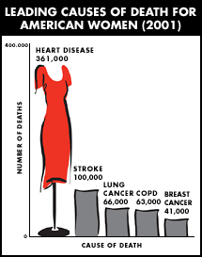
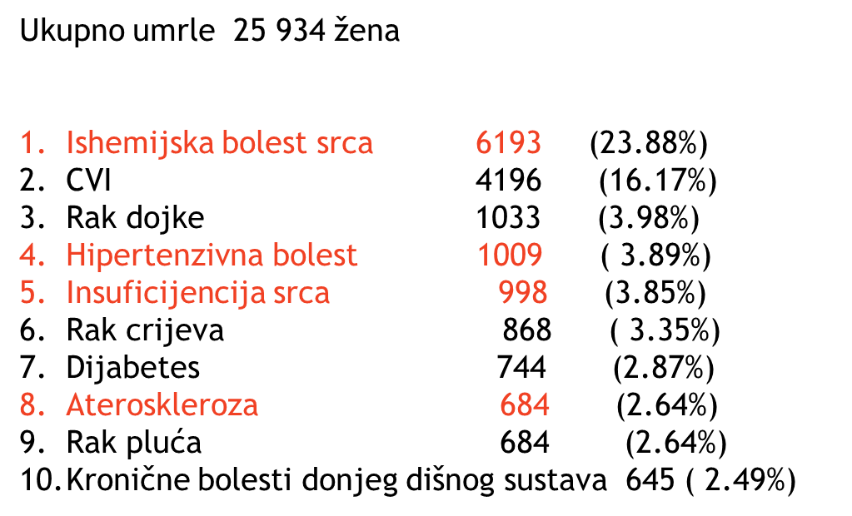
15x više umiru od KVB nego od raka dojke
10 vodećih uzroka smrti žena u 2012.
Notes:
In fact, as we heard on the news after the death of Christopher Reeves’ widow…lung cancer is actually the leading cancer killer…Despite impressions to the contrary, cardiovascular disease is the leading cause of death among women in the United States, as it is among men.¹ However, myocardial infarction and stroke are uncommon in women until their sixth decade and beyond. Clinicians have long suspected that the delay of a decade or more in cardiovascular disease expression in women relative to men is due to the protective effects of estrogen during a woman’s reproductive years. Women in the Nurses’ Health Study who underwent surgical menopause by bilateral oophorectomy without estrogen replacement had more than twice the risk of subsequent clinically apparent coronary heart disease as postoperative women who received estrogen therapy.² In recent years, reports from population-based observational studies of favorable effects of estrogen therapy on cardiovascular morbidity and mortality³ ⁴ ⁵ have led to enthusiasm for widespread use of estrogen by postmenopausal women for prevention of cardiovascular disease events. The guidelines for estrogen therapy issued by the American College of Physicians include the statement, “Women who have coronary heart disease or who are at increased risk for coronary heart disease are likely to benefit from hormone therapy.”

Slide 20
Kardiovaskularno zdravlje
Što žene misle? Od čega će umrijeti ?:
RAK DOJKE 40-60%
KARDIOVASKULARNE BOLESTI 15-18%
Od čega zapravo umiru?:
KARDIOVASKULARNE BOLESTI 53%
RAK DOJKE 4%
Notes:
Several surveys of women reveal about the following awareness levels… The most recent survey increased awareness of heart disease risk to about 10-12%

Slide 21
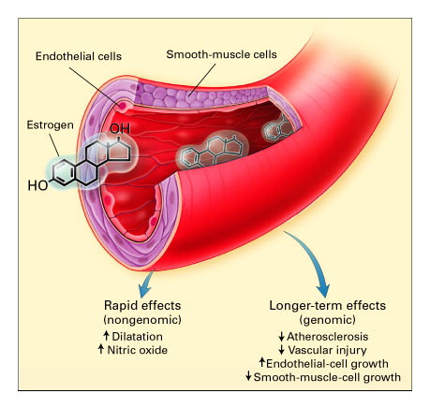
Mendelsohn ME, Karas RH. N Engl J Med 1999;340:1801-1811.
Izravni učinak estrogena na krvožilni sustav
Mitohondrijski transport elektrona
kontraktilnost
Ionski kanali i repolarizacija
Inflamatorni odgovor
Dijabetes i inzulinska osjetljivost
Preživljenje stem cells
Vaskularna funkcija i ateroskleroza
Hipertrofija srca
Veličina infarkta i ishemijska reperfuzija
Notes:
Figure 1. Direct Effects of Estrogen on Blood Vessels. Vascular endothelial and smooth-muscle cells express the two known estrogen receptors. Estrogen has both rapid vasodilatory effects and longer-term actions that inhibit the response to vascular injury and prevent atherosclerosis. These effects are mediated by direct actions on vascular endothelial cells (red) and smooth-muscle cells (purple). The rapid effects of estrogen on the blood-vessel wall are believed to occur without any changes in gene expression (nongenomic effects), whereas the longer-term effects involve changes in gene expression (genomic effects) mediated by the estrogen receptors, which are ligand-activated transcription factors.

Slide 22
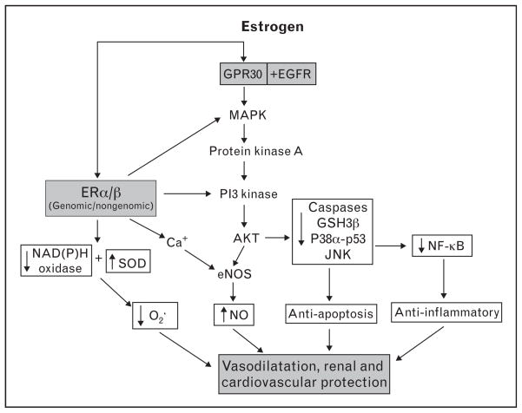
Mogući mehanizmi estrogen-potaknute vazodilatacije, renalne i kardiovaskularne protekcije
Teorija zdravog endotela
brojni su dokazi da estrogeni (HNL) ostvaruju kardioprotektivnost samo kod zdravog KVS
diskreditiran je genomski i
negenomski učinak E

Slide 23
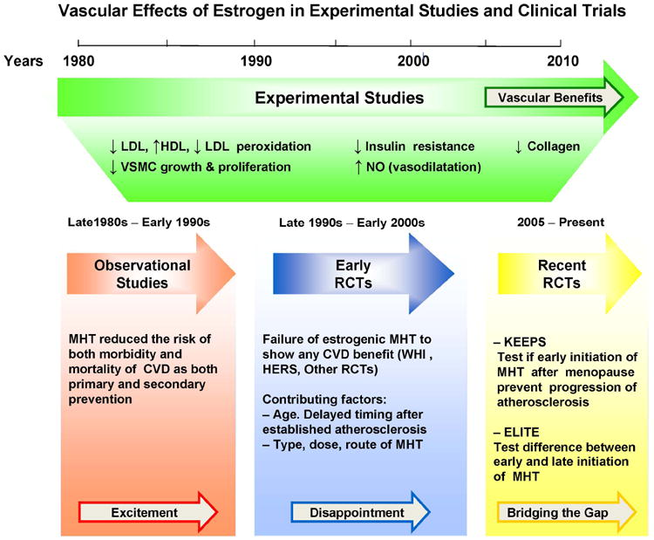
Vaskularni učinci estrogena u eksperimentalnim i kliničkim studijama
Notes:
Discrepancies in the vascular effects of estrogen in experimental studies and RCT. Experimental studies largely and consistently demonstrate vascular benefits of estrogen. The excitement generated from the vascular benefits of estrogen observed in initial ... Nedvojbeno je da biološki estrogeni djeluju kardioprotekvino. Isto je mislio i za sintetske estrogene. Naime od 1960 do 1988 objavljeno je više od 1000 eksperimentalnih, opservacijski i epdemiloških studija, kao i 3 metaanalize koje su zaključile da HNl smanjuje rizik za KVB i CVI za 30-40%, usporavaju aterosklerozu, smanjuju rizik za ponovni KV, smanjuju smrtnost, odnosno da imaju i primarnu i sekundarnu kadioprotekciju.

Slide 24
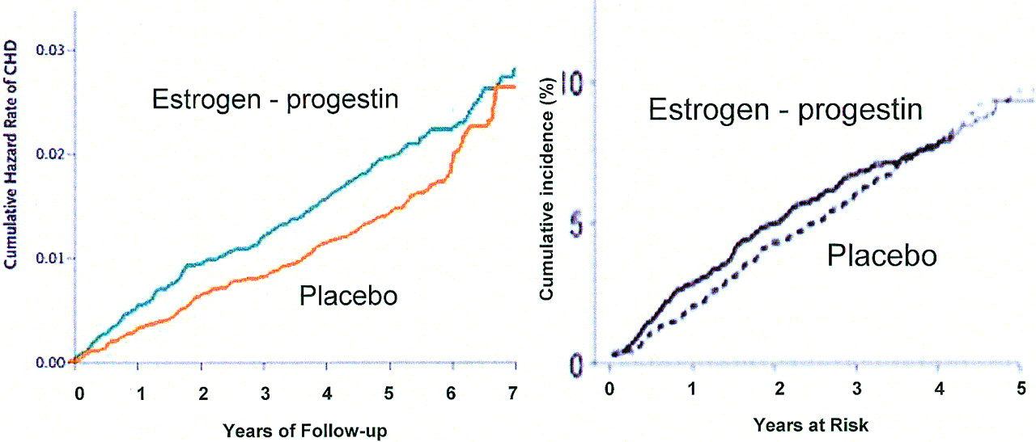
Time course of coronary heart disease (CHD) events in the Women’s Health Initiative (WHI) estrogen–progestogen trial (left panel) and the Heart and Estrogen/progestin Replacement Study (HERS) trial (right panel) (Manson et al., 2003, Copyright © 2003 Massachusetts Medical Society.
35% hipertenzija
35% debele (BMI 25-29)
34% vrlo debele (BMI>30)
4% dijabetes
12,5% povišeni kolesterol
16% familijarna anamneza za rak dojke
6,9% statine
19,0% aspirin
7,7% ranije KV inzult
Istraživane žene su imale rizik za KVB
The ESHRE Capri Workshop Group et al. Hum. Reprod. Update 2006;12:483-497
Notes:
Time course of coronary heart disease (CHD) events in the Women’s Health Initiative (WHI) estrogen–progestogen trial (left panel) and the Heart and Estrogen/progestin Replacement Study (HERS) trial (right panel) (Manson et al., 2003, Copyright © 2003 Massachusetts Medical Society. All right reserved; Hulley et al., 1998—permission granted).

Slide 25
Starenje: progresija koronarne ateroskleroze
CRO
vulnerabilni plak
Adventicija
MMP-9
Fibrozna kapa
Media
Fibrozna
kapa
Fibrozna
kapa
Internal Elastic Lamina
Plak
Plak
Masni plak
Plak
Nekrotična Jezgra
Nekrotična jezgra
50
50
55
60
65
70
dob
Godine u postmenopauzi:
0–5
5–15
>15
NHS
WHI
HERS
WEST
ZDRAV ENDOTEL
↑ E₂R
Notes:
Typical progression of atherosclerosis with age is shown here. The small coronary artery atherosclerotic lesion on the far left is typical of those present in the average American woman at the end of the perimenopausal transition and beginning of the menopause.
Progression of atherosclerosis involves a complex series of inflammatory processes that eventually lead to formation of a mature, complicated atherosclerotic lesion, depicted on the far right.
Note that instead of absolute age, this slide emphasizes the correlation between years postmenopause and the stages of progression of atherosclerosis.

Slide 26
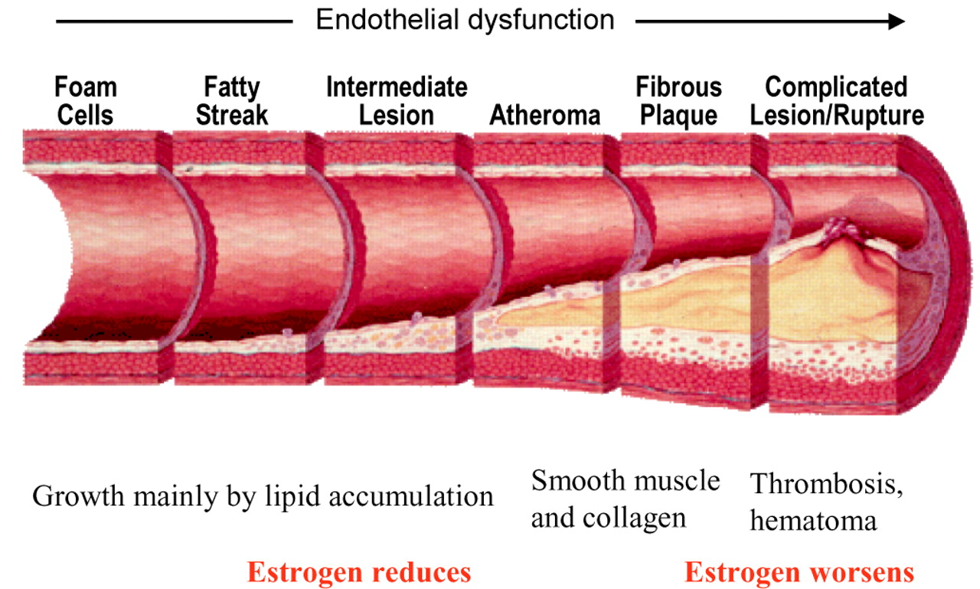
Kronologija razvoja ateroskleroze
[reprinted from Am J Cardiol 82 (Suppl 10a), Pepine (1998), Copyright © 1998, with permission from Excerpta Medica, Inc.].
The ESHRE Capri Workshop Group et al. Hum. Reprod. Update 2006;12:483-497
Notes:
Chronology of the development of atherosclerosis [reprinted from Am J Cardiol 82 (Suppl 10a), Pepine (1998), Copyright © 1998, with permission from Excerpta Medica, Inc.]. Estradiol (E₂) reduces the development of early lesions of atherosclerosis, in part through the effects on lipid metabolism which reduce lipid deposits in the endothelium. Once the atheroma is established, however, estrogens increase MMP expression, which may promote disruption of the fibrous cap and subsequent rupture of the plaque. If the capsule does rupture causing turbulent blood flow, E₂ is thrombogenic and clot formation may occlude the arterial lumen (Phillips and Langer, 2005). Through different mechanisms, therefore, estrogens inhibit early development of atherosclerosis but increase the risk of damage once atherosclerosis has been established.

Slide 27
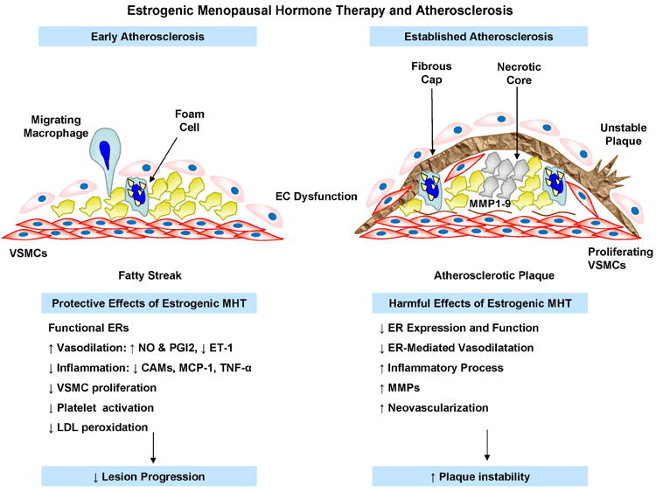
Notes:
Differential protective effects of estrogenic MHT in early atherogenesis and harmful effects in established atherosclerosis. In early atherogenesis cardiovascular risk factors, hemodynamic forces, and circulating inflammatory factors cause endothelial ...

Slide 28
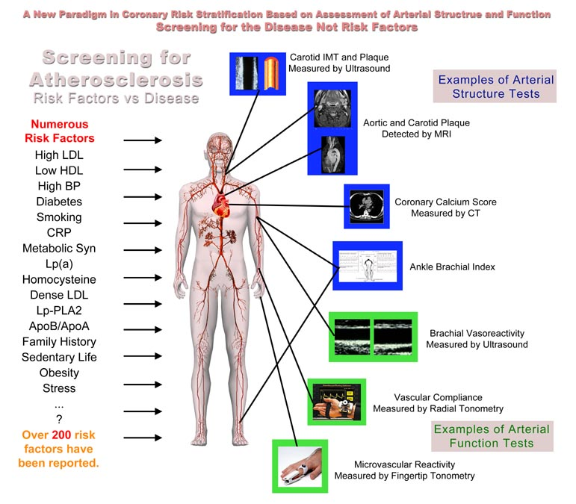
Probir za aterosklerozu
Rizični f vs bolest

Slide 29
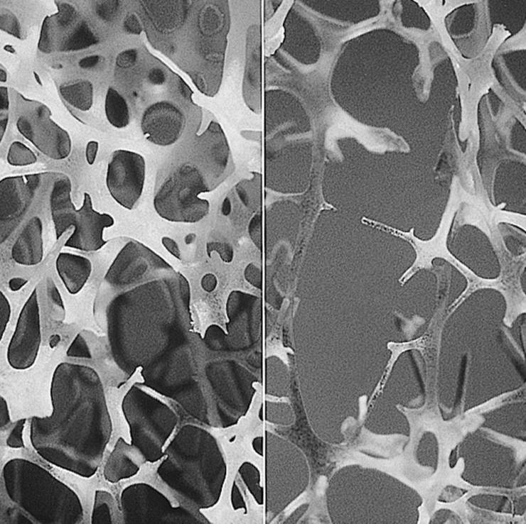
Osteoporoza
Progresivna sistemska bolest različitih uzroka
smanjenje koštane mase i gustoće
propadanje mikroarhitektonike kosti
- slabljenje skeleta s povećanim rizikom prijeloma kralježnice, podlaktice, kuka i zdjelice
- uzrokuje bolnu nemoć, gubitak visine i pogrbeljnost
- smrtnost češća nego kod pneumonije, upala, srčanog popuštanja ili nekih vrsta tumora
ZDRAVA KOST
OSTEOPOROZA
Notes:
Osteoporoza je progresivna sistemska bolest kojoj uzroci mogu biti različiti. Karakterizirana je smanjenjem koštane mase i gustoće te propadanjem mikroarhitektonike kosti. Posljedično dolazi do slabljenja skelete s povećanim krizikom prijeloma kralježnice, podlaktice, kuka i zdjlice, uzrokuje nemoć, gubitak visine i pogrbljenost. A smkrtnost je češća nego kod pneumonije, upala, srčanog popuštanja ili nekih vrsta tumora.

Slide 30
Source:
Osteoporoza: Veličina problema
Review:
Novi slučajevi karcinoma dojke 175 000 / godišnje¹
Novi slučajevi KVB 334 512 / godišnje¹
Osteoporotična fraktura 1.5 milijuna / godišnje u SAD (700 000 kralješka, 250 000 kuka, 250 000 podlaktice, 300 000 nevertebralne frakture) ^{2,3}
Reviewer Memo:
¹ America’s Bone Health: The State of Osteoporosis and Low Bone Mass in Our Nation. Washington, DC: National Osteoporosis Foundation 1-12, 2002
² Women’s Health Facts and Figures. Washington, DC. American College of Obstetricians and Gynecologist; 2000
3 NIH Consensus Development Panel on osteoporosis prevention, diagnosis and therapy. JAMA 2001;285:785-795
Slide Modified:
Memo:
Notes:
Ovaj vam slide želim pokazati samo da vidite koliko je osteoporoza veliki problem. Broj žena koje dožive osteoporotičnu frakturu značajno je veći od onih koje obole od karcinom dojke ili kardiovaskularnih bolesti. Dok se u SAD-u godišnje dijagnosticira oko 175 tisuća novih karcinoma dojke, odnosno 340 tisuća novih pacijenata s KVB bolestima, dijagnoza osteoporotične frakutre postavi se u oko 1,5 milijuna žena. Od toga su najčešće osteoporotične frakture kralješaka (gotovo polovica svih fraktura)

Slide 31
„Lifetime Changes” u koštanoj masi
Peak
koštana
masa
Dob ovisan
Gubitak mase
k
o
š
t
Muški
20-30%
Menopausal
gubitak
mase
a
n
a
Prijevremena menopauza
Žene
30-50%
m
a
s
a
80
20
40
60
dob
Notes:
This slide shows how bone mass in women and men varies with age.
Bone is laid down in our teens and early 20’s and reaches its peak between 25 and 35.In women bone is gradually lost at about 1% per year from the age of 35 years until the menopause is reached at about 51 years of age when it declines more rapidly at between 3-6% per year for 10years or so. Bone loss then slows again to 1%per year and continues to to decline for the rest of our lives to a total normal loss of around 45% of peak bone mass.
The picture is similar in men however men are less at risk of osteoporosis as they have a higher peak bone mass and they do not have a menopause with a high rate of bone loss. In men age-related bone loss starts at about 50 years of age and declines at about 1% per year.They have a shorter life expectancy so have fewer years in which to deplete bone
Whether a woman develops osteoporosis depends on her peak bone mass, rate of post-menopausal bone loss and her longevity.Osteoporosis is therefore usually an age related disease.

Slide 32
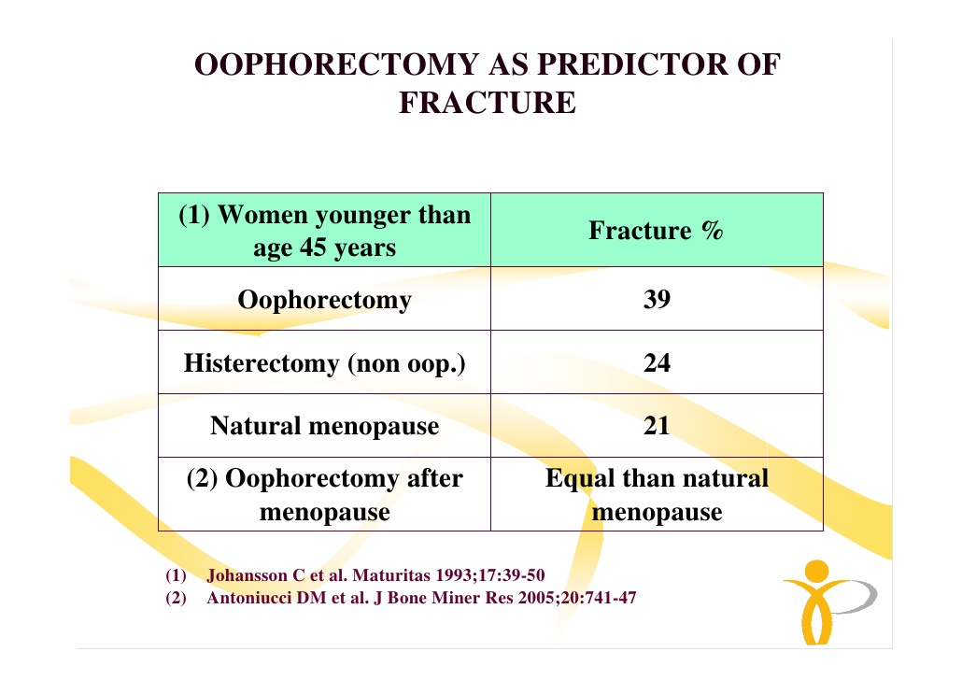

Slide 33
Estrogeni i kost
Estrogeni
metabolizam Ca
izravno
neizravno
stromalne stanice
vitamin D₃
osteoblast
citokini
PTH
osteoklast
Notes:
Kakvu ulogu imaju estogeni u etiologiji osteoporoze? Kost je živit organ koji stalno prolazi proces izgradnje za što su odgovorni osteoblasti i razgradnje za što su odgovorni osteoklasti.Osteoblasti i osteoklasti nastaju iz prekursorskih stromalnih stanica posredstvom citokina porcesom koji je reguliran spolnm steroidima. Izgradnja odnosno razgradnja kosti pod utjecajem je PTH, vitamina D i metabolizma Ca. I na te procese neizravno djeluju estrogeni.

Slide 34
Ciljevi farmakološkog liječenja
Osteoklast
Osteoblast
Inhibicija resorpcije
Stimulacija formacije

Slide 35
Farmakoterapija - pregled
Liječenje
Djelovanje
Hormonsko nadomjesno liječenje
SERMs
Inhibicija resorpcije kosti
Održanje ili porast koštane
mase
Redukcija rizika frakture
Kalcitonin
Bisfosfonati
Denosumab
Vitamin D, kalcij
Porast stvaranja kosti
Održanje ili porast koštane
mase
Redukcija rizika frakture
Parathyroid hormon

Slide 36
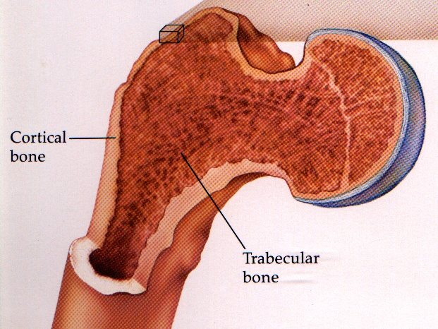
Kome primjeniti HNL? Indikacije za korištenje HNL
Prevencija i liječenje postmenopauzalne osteoporoze u:
Simptomatskih žena
Asimptomatskih žena sa čimbenicima rizika
mlađih od 60 godina
Čimbenici rizika za osteoporozu
Genetski: Osteoporoza u obitelji
Fraktura u odrasloj dobi
BMI < 20
Pušenje < 20 cigareta/d
Izražena konzumacija alkohola
Prijevremena menopauza
Anoreksija
Smanjen unos kacija
Sedentarni način života
Kortikosteroidi, tireostatici, SSRI..
Depresija
Osteopenia T-score -1 do -2.5
Notes:
Prevencija i liječenje postmenopauzalne osteoporoze. I mi to često usput radimo u simptomatskiih žena. No mi ginekolozi često zaboravljamo, da je HNL indicirano i kod asimptomatskih žena mlađih od 60 godina koje imaju čimbenike rizika za nastanak osteoporoze. A mi često zaboravimo pitati za te čimbenike rizika koji su kao što znate: osteoporoza u obitelji, fraktura u odrasloj dobi, nizak body mass indeks, izaženo puštenje i konzumacija alkohola, dugotrajna amenoreja u anamnezi, smanjen unos kalcija, sedentarni način života i korištenje nekih lijekova. Dakle takvim je ženama indicirano učiniti denzitometriju i ukoliko je T-score od -1 do -2.5 potrebno je primjeniti HNL.

Slide 37
HNL i rizik za frakture
Metaanaliza 22 klinička pokusa
Mlađe od 60 god.
RR=0,67 –sve frakture
RR=0,45 –kuk i šake
Starije od 60 god.
RR=0,88 –za sve
RR=0,60 –kuk i šake
Ukupno RR=0,73
Torgerson,JAMA 2001
Estrogeni snizuju rizik za frakture
za 30-50% ako se koriste dugotrajno
i ako su započeti u prve 3 godine menopauze. 10 autora-1985-1995.
Notes:
Metaanaliza 22 klinička pokusa zaključila je da HNL smanjuje rizik za frakture i to za 30-50% poglavito ako se koriste dugotrajno i ako su započeti u prve 3 godine menopauze.

Slide 38
HNL rano kroz 3 godine → zauvijek bolja kost
100
98
Maturitas 1998;31:45-54
96
E/P
94
Vit. D
92
% without fractures
15 godišnja studija HT
90
HNL rano kroz 3 godine → zauvijek bolja kost
8% viši BMD - 50% redukcija rizika fraktura trajno
88
Placebo
86
84
0
1
2
3
4
5
(Years)
Christiansen, October, 2004.
Notes:
Legendarna studija Kristijansena još prije 10 godina pokazala je da HNL smanjuje rizik za frakture

Slide 40

Take Charge of Your Heart, Your Health, & Your Life!

